Slide 1

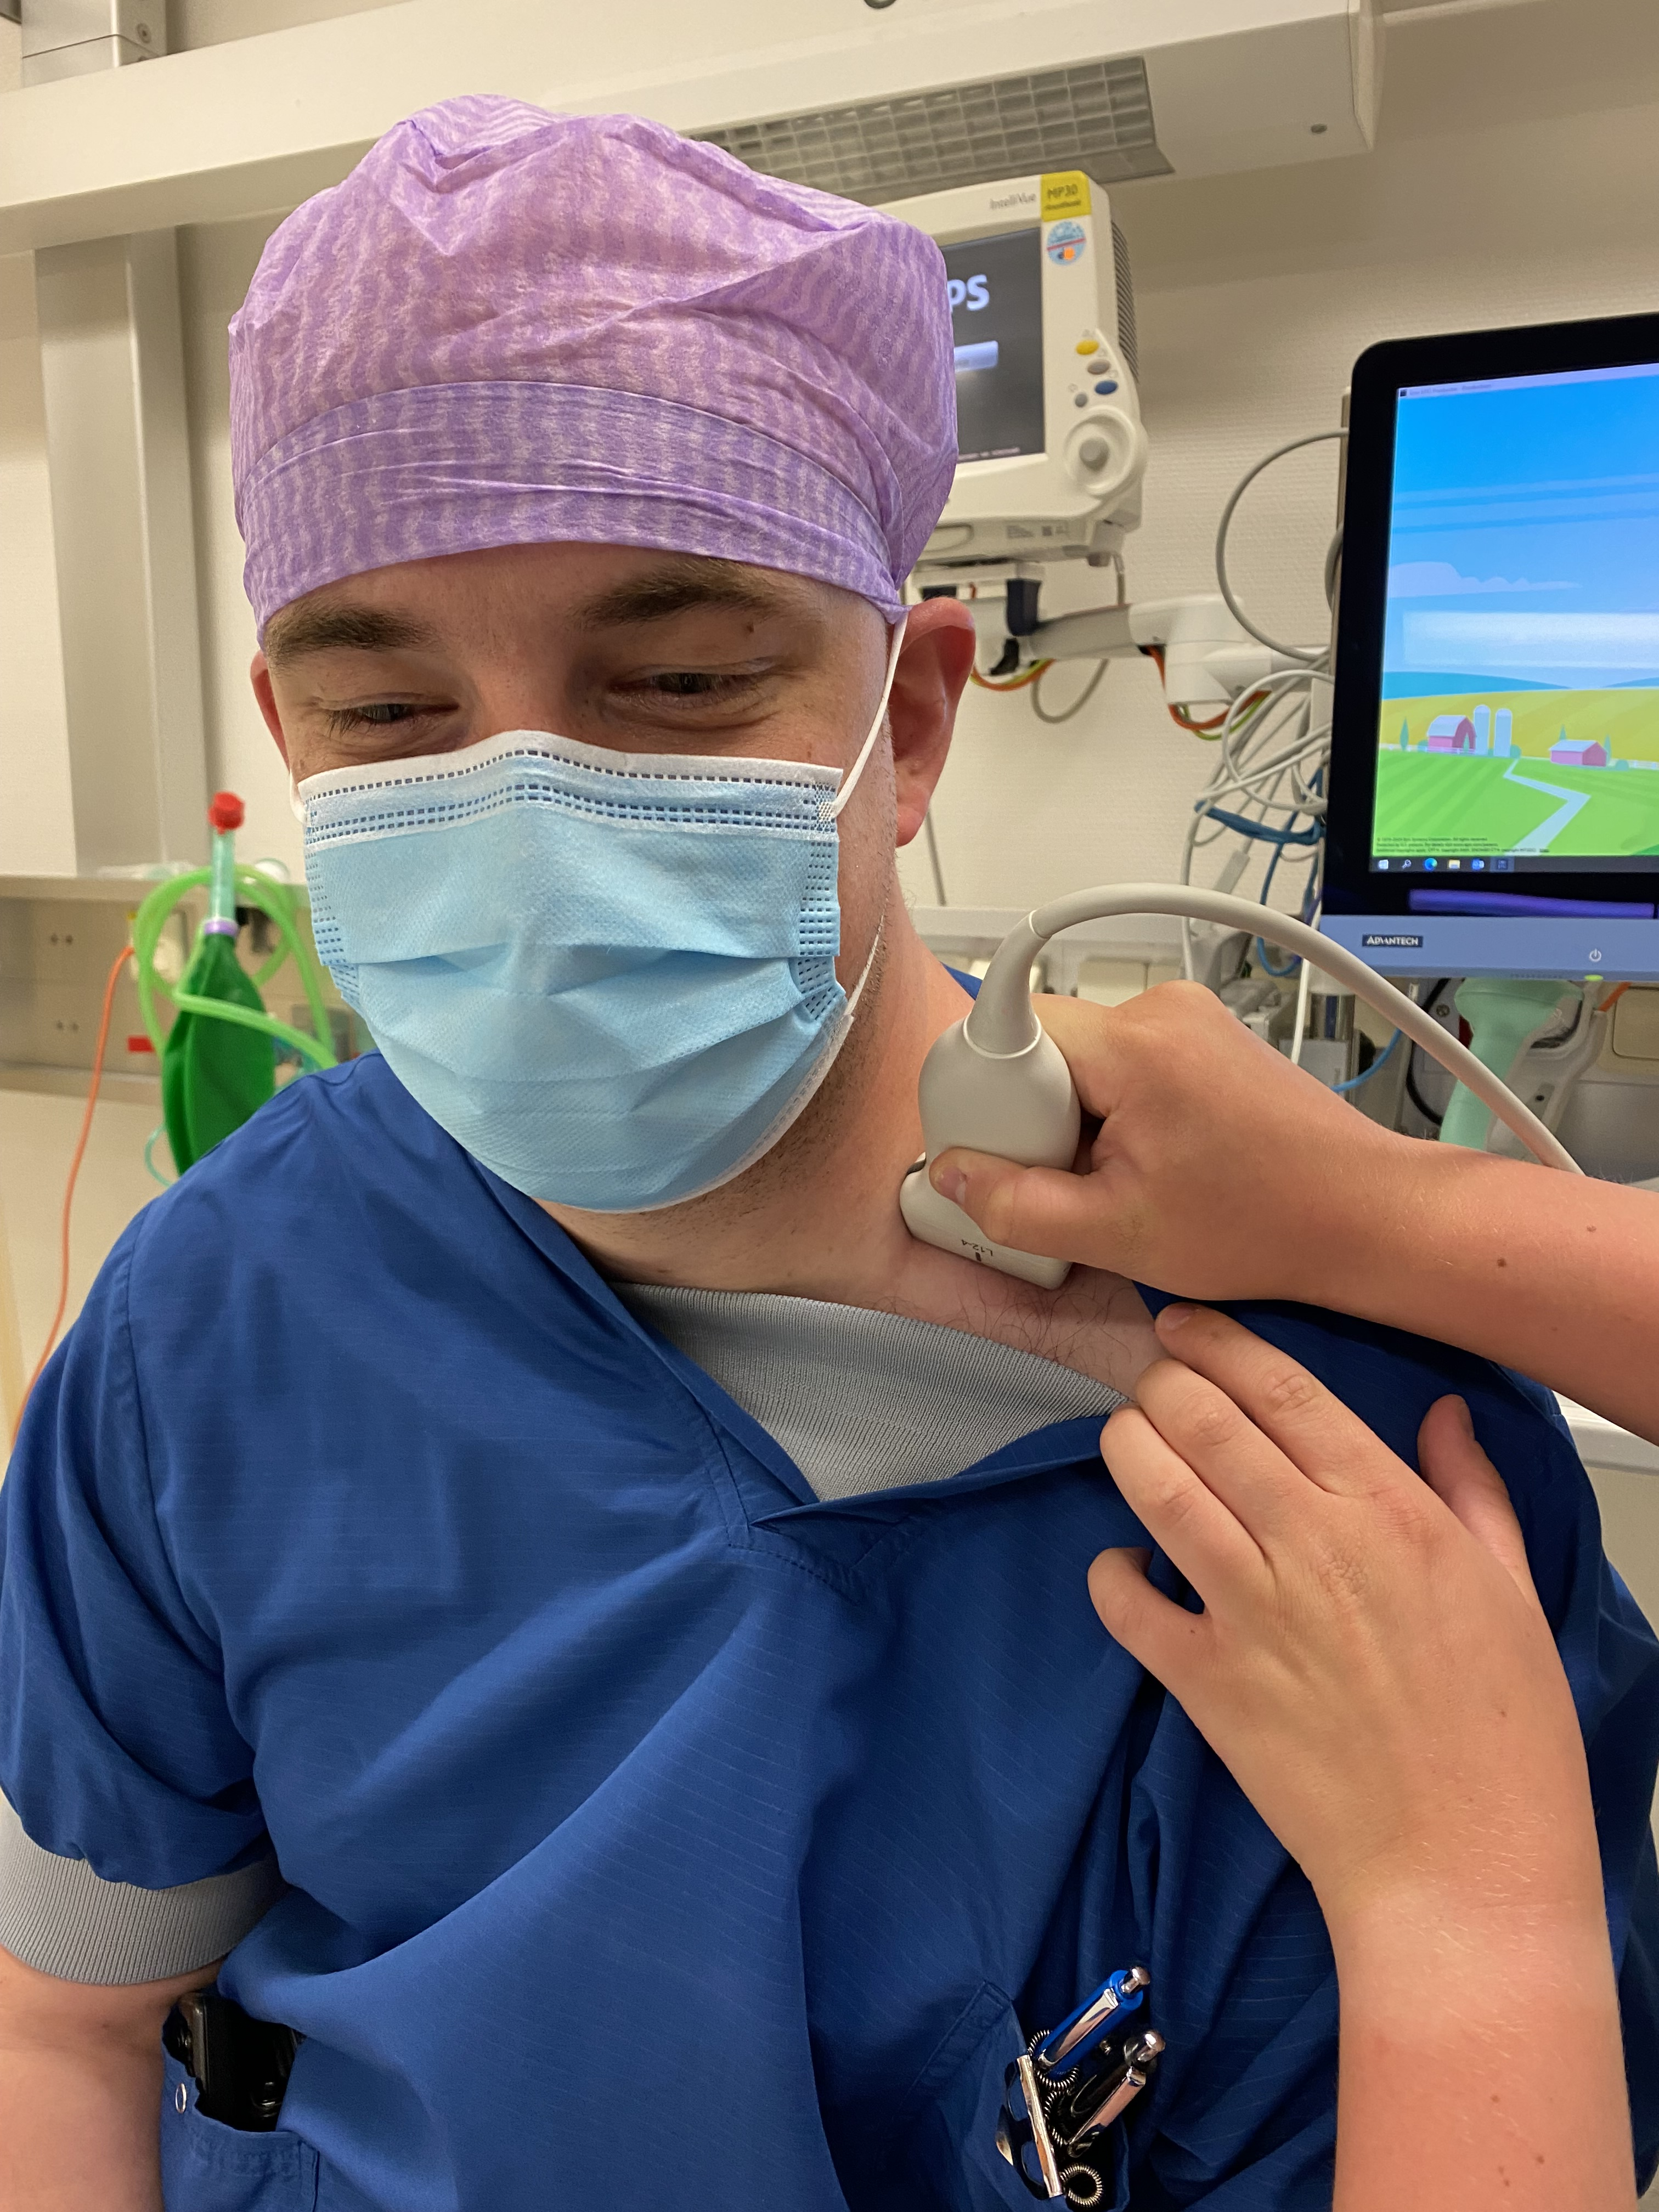

Plexus brachialis studie
Stap 1
Stap 2

